Slide 1
INTERNSHIPS & RESEARCH

Slide 2
CAREER & PROFESSIONAL DEVELOPMENT CENTER
Career Studio | Coaching | Resources | Events
801-581-6186 • careers@sa.utah.edu • careers.utah.edu • @uofucareers

Slide 3
WHERE ARE YOU AT WITH RESEARCH AND/OR INTERNSHIPS?

Slide 4
AGENDA
What is experiential learning?
How do I choose?
How do I apply?
Q&A

Slide 5
WHAT IS EXPERIENTIAL LEARNING?

Slide 6
Experiential Learning
A way to learn through experience
Explore interests, studies, and future career paths
Develop skills while networking
Learn likes and dislikes
Build resume/CV

Slide 7
Why does it matter?
Nearly 91 % of employers prefer that their candidates have work experience, and 65 % of the total group indicate that they prefer their candidates to have relevant work experience.

Slide 8
HOW DO I CHOOSE?

Slide 9
Experiential Learning
Similarities
You can do both!
Experience for grad school applications
Make real-world impact
Create a network

Slide 10
Experiential Learning
Internships
Research
Industry
Supervisor
Time-bound
Learning objectives
Guided training
Hands-on skills
Academia
Faculty / Principal Investigator
Fluctuating
Literature progression
Autonomy
Publications

Slide 11
WHAT IS YOUR IDEAL OPPORTUNITY?
Use the worksheet in the chat to help determine your values.

Slide 12
HOW DO I APPLY?

Slide 13
Applying for Internships
See a Career Coach or Internship Coordinator
Make a list of your interests
Create/update your resume and cover letter
Search for opportunities online
Network
Cast a wide net
Negotiate/clarify terms

Slide 14
Applying for Research
See your Undergraduate Research Advisor.
Make a list of your interests
Connect with faculty and peers
Create/Update your query letters and/or proposals
Search for opportunities
Attend seminars and workshops
Explore funding, course credit, and/or publication

Slide 15
QUESTIONS?

Slide 16
CAREER STUDIO & CAREER COACHING

Slide 17
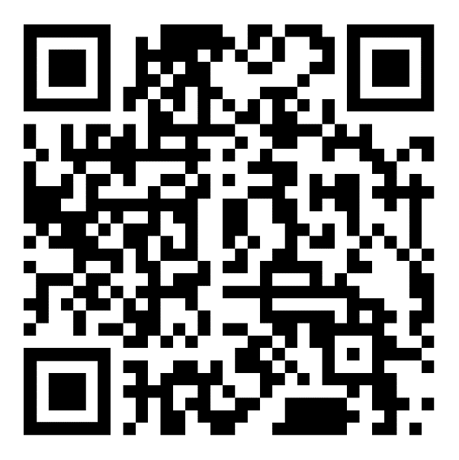
ASSESSMENT

